Slide 1
Data Structures Inverted Search
Notes:
1

Slide 2
Project1 – Inverted Search
Notes:
2

Slide 3
Data Structure –Project Inverted Search
What ?
Notes:
3

Slide 4
Data Structure –Project Inverted Search
What ?
An inverted index is an index data structure storing a mapping from content,
such as words or numbers, to its locations in a table, or in a document or
a set of documents.
Notes:
4

Slide 5
Data Structure –Project Inverted Search
What ?
What ?
An inverted index is an index data structure storing a mapping from content,
such as words or numbers, to its locations in a table, or in a document or
a set of documents
Purpose
The purpose of an inverted index is to allow fast full text searches,
at a cost of increased processing when a document is added to the database.
Notes:
5

Slide 6
Data Structure –Project Inverted Search
Types
1. Forward Indexing
2. Inverted Indexing
Notes:
6

Slide 7
Data Structure –Project Inverted Search
Inverted Indexing
It is a data structure that stores mapping from words to documents or set of documents i.e. directs you from word to document.
Notes:
7

Slide 8
Data Structure –Project Inverted Search
Inverted Indexing
Scan the documents, prepare a list of unique words.
Prepare a list of indices of all the unique words and map them to a document search
Doc1
Hi
Doc1, Doc2
Hi Hello
How Are You
Hello
Doc1
How
Doc1, Doc2
Words
Are
Doc1
Documents
You
Doc1
Doc2
I
Doc2
I Am Good
Hi How
Am
Doc2
Good
Doc2
Notes:
8

Slide 9
Data Structure –Project Inverted Search
Inverted Indexing
It is a data structure that stores mapping from words to documents or set of documents i.e.
directs you from word to document.
Forward Indexing
It is a data structure that stores mapping from documents to words i.e. directs you from document to word.
Notes:
9

Slide 10
Data Structure –Project Inverted Search
Forward Indexing
Scan the document,prepare a list of unique words
Map all the words to a document as an index
Doc1
Documents
Doc1
Doc2
Hi Hello
How Are You
Hi
I
Hello
Am
Doc2
How
Good
I Am Good
Hi How
Are
Hi
You
How
Notes:
10

Slide 11
Data Structure –Project Inverted Search
Inverted Indexing
It is a data structure that stores mapping from words to documents or set of documents i.e.
directs you from word to document.
Real life example of Inverted index:
Index at the back of the book.
Forward Indexing
It is a data structure that stores mapping from documents to words i.e. directs you from document to word.
Real life examples of Forward index:
Table of contents in book
Notes:
11

Slide 12
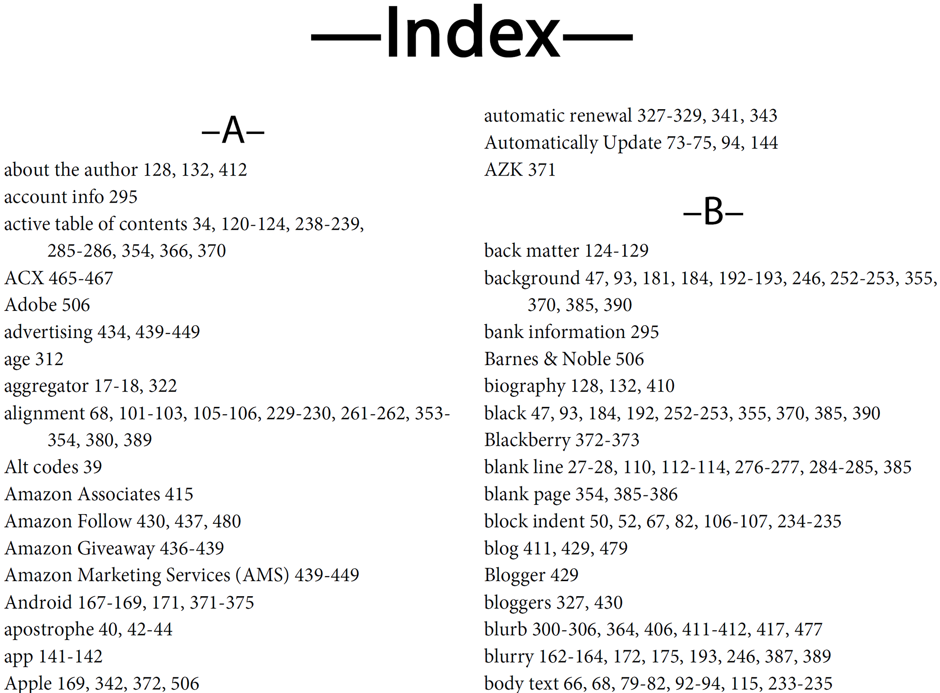
Data Structure –Project Inverted Search
Inverted Indexing
It is a data structure that stores mapping from words to documents or set of documents i.e.
directs you from word to document.
Real life example of Inverted index:
Index at the back of the book.
Notes:
12

Slide 13
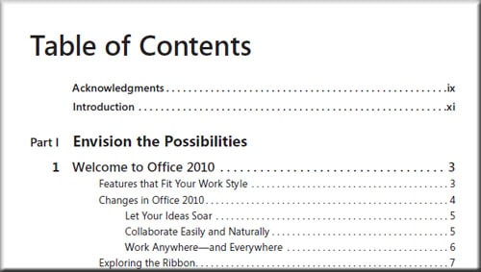
Data Structure –Project Inverted Search
Forward Indexing
It is a data structure that stores mapping from documents to words i.e. directs you from document to word.
Real life examples of Forward index:
Table of contents in book
Notes:
13

Slide 14



Data Structure –Project Inverted Search
Advantages of inverted Index:
It is easy to develop
It is used in document retrieval system
Search engines
Notes:
14

Slide 15
Data Structure –Project Inverted Search
Operations:
Create Database
Display Database
Search Database
Update Database
Save Database
Notes:
15

Slide 16
Create Database
Notes:
16

Slide 17
Data Structure –Project Inverted Search
File1.txt
hi hello how are you
Create Database:
File2.txt
1. Main node
2. Sub node
hello hi i am fine
word
count
File count
word
File name
Sub node
link
Link for
next node
link
Main node
Sub node
Notes:
17

Slide 18
Data Structure –Project Inverted Search
File1.txt
hi hello how are you
Index = data % 97
= ‘h’ % 97
= 7
Create Database:
File2.txt
0
hello hi i am fine
1
2
3
4
5
7
1
hi
N
1
File1.txt
N
25
Notes:
18

Slide 19
Data Structure –Project Inverted Search
File1.txt
hi hello how are you
Index = data % 97
= ‘h’ % 97
= 7
Create Database:
File2.txt
0
hello hi i am fine
1
2
3
4
5
7
1
hi
1
hello
N
1
1
File1.txt
File1.txt
N
N
25
Notes:
19

Slide 20
Data Structure –Project Inverted Search
File1.txt
hi hello how are you
Index = data % 97
= ‘h’ % 97
= 7
Create Database:
File2.txt
0
hello hi i am fine
1
2
3
4
5
7
1
hi
1
hello
1
how
N
1
1
1
File1.txt
File1.txt
File1.txt
N
N
N
25
Notes:
20

Slide 21
Data Structure –Project Inverted Search
File1.txt
hi hello how are you
Index = data % 97
= ‘a’ % 97
= 0
Create Database:
1
are
File2.txt
0
N
hello hi i am fine
1
2
1
3
File1.txt
4
N
5
7
1
hi
1
hello
1
how
N
1
1
1
File1.txt
File1.txt
File1.txt
N
N
N
25
Notes:
21

Slide 22
Data Structure –Project Inverted Search
File1.txt
hi hello how are you
Index = data % 97
= ‘h’ % 97
= 7
Create Database:
1
are
File2.txt
0
N
hello hi i am fine
1
2
1
3
File1.txt
4
N
5
7
1
hi
2
hello
1
how
N
1
1
1
File1.txt
File1.txt
File1.txt
N
1
N
25
File2.txt
Notes:
22

Slide 23
Data Structure –Project Inverted Search
File1.txt
hi hello how are you
Index = data % 97
= ‘h’ % 97
= 7
Create Database:
1
are
File2.txt
0
N
hello hi i am fine
1
2
1
3
File1.txt
4
N
5
7
2
hi
2
hello
1
how
N
1
1
1
File1.txt
File1.txt
File1.txt
1
1
N
25
File2.txt
File2.txt
N
N
Notes:
23

Slide 24
Data Structure –Project Inverted Search
File1.txt
hi hello how are you
hi
Create Database:
1
are
File2.txt
0
N
hello hi i am fine
1
2
1
3
File1.txt
4
N
5
7
2
hi
2
hello
1
how
N
1
1
1
File1.txt
File1.txt
File1.txt
1
1
N
25
File2.txt
File2.txt
N
N
Notes:
24

Slide 25
Data Structure –Project Inverted Search
File1.txt
hi hello how are you
hi
Create Database:
1
are
File2.txt
0
N
hello hi i am fine
1
2
1
3
File1.txt
4
N
5
7
2
hi
2
hello
1
how
N
2
1
1
File1.txt
File1.txt
File1.txt
1
1
N
25
File2.txt
File2.txt
N
N
Notes:
25

Slide 26
Data Structure –Project Inverted Search
Create Database:
Create nodes:
Sub node :
Main node :
typedef struct sub
{
int word_count;
char f_name[FNAME_SIZE];
struct sub *link;
}subnode_t;
typedef struct mainnode
{
int file_count;
char word[WORD_SIZE];
struct mainnode *link;
subnode_t *link;
} mainnode_t;
Notes:
26

Slide 27
Data Structure –Project Inverted Search
Create Database:
Rules:
1 If Words are same and Filenames are also same
-> Increment word count
2. If words are same and Filenames are different
-> Increment file count and allocate memory for table link
3. If word are different and Filenames are different
-> Allocate the entire block(main and sub)
4.If words are different and filenames are same
-> Allocate the entire block(main and sub)
Notes:
27

Slide 28
Data Structure –Project Inverted Search
f_name node :
typedef struct file
{
char filename[WORD_SIZE];
struct file *link;
}filenames_t;
Create Database:
Create nodes:
Sub node :
Main node :
typedef struct sub
{
int word_count;
char f_name[FNAME_SIZE];
struct sub *link;
}subnode_t;
typedef struct mainnode
{
int file_count;
char word[WORD_SIZE];
struct mainnode *link;
struct sub *link;
} mainnode_t;
Notes:
28

Slide 29
Display Database
Notes:
29

Slide 30
Data Structure –Project Inverted Search
Display Database:
Printing Pattern:
1. Search for the index which is not empty.
2. Display the index number and details as follows.
-> [ind_no] <word> <file_count> <filename> <word_count>
Notes:
30

Slide 31
Data Structure –Project Inverted Search
Display Database:
[0] [are] 1 file(s) : file : File1.txt : 1 time(s)
[7] [hi] 2 file(s) : file : File1.txt : 2 time(s) : File2.txt : 1 time(s)
[hello] 2 file(s) : file : File1.txt : 1 time(s) : File2.txt : 1 time(s)
[how] 1 file(s) : file : File1.txt : 1 time(s)
Notes:
31

Slide 32
Search Database
Notes:
32

Slide 33
Data Structure –Project Inverted Search
Search Database:
Read the word to be searched in Database
Example the word is hi
Notes:
33

Slide 34
Data Structure –Project Inverted Search
Index = data % 97
= ‘h’ % 97
= 7
Search Database:
1
are
0
N
1
Word ‘hi’ is found at the database and it present in 2 files
In file File1.txt 2 time(s)
In file File2.txt 1 time(s)
2
1
3
File1.txt
4
N
5
7
2
hi
2
hello
1
how
N
2
1
1
File1.txt
File1.txt
File1.txt
1
1
N
25
File2.txt
File2.txt
N
N
Notes:
34

Slide 35
Data Structure –Project Inverted Search
Index = data % 97
= ‘h’ % 97
= 7
Word to be searched:
hello
Search Database:
1
are
0
N
1
Word ‘hello’ is found at the database and it present in 2 files
In file File1.txt 2 time(s)
In file File2.txt 1 time(s)
2
1
3
File1.txt
4
N
5
7
2
hi
2
hello
1
how
N
2
1
1
File1.txt
File1.txt
File1.txt
1
1
N
25
File2.txt
File2.txt
N
N
Notes:
35

Slide 36
Update Database
Notes:
36

Slide 37
Data Structure –Project Inverted Search
File3.txt
how are you
Update Database:
Read the file to be added in Database
Let’s say the file name is file3.txt
Notes:
37

Slide 38
Data Structure –Project Inverted Search
Index = data % 97
= ‘h’ % 97
= 7
File3.txt
Update Database:
how are you
1
are
0
N
1
2
1
3
File1.txt
4
N
5
2
hi
2
hello
1
7
2
how
N
2
1
1
File1.txt
File1.txt
File1.txt
1
1
N
1
25
File2.txt
File2.txt
File3.txt
N
N
N
Notes:
38

Slide 39
Data Structure –Project Inverted Search
Index = data % 97
= ‘a’ % 97
= 0
File3.txt
Update Database:
how are you
2
1
are
0
N
1
2
1
1
3
File1.txt
File3.txt
4
N
N
5
7
2
hi
2
hello
2
how
N
2
1
1
File1.txt
File1.txt
File1.txt
1
1
N
1
25
File2.txt
File2.txt
File3.txt
N
N
N
Notes:
39

Slide 40
Save Database
Notes:
40

Slide 41
Data Structure –Project Inverted Search
Save Database:
Read the backup file name.
Let’s say the file name is backup.txt
Store the contents in given pattern.
#<index_no>;
<word>;<file_count>;<file_name>;<word_count>#
Notes:
41

Slide 42
Validations
Notes:
42

Slide 43
Data Structure –Project Inverted Search
Validations :
Check the filename passed through CL.
If yes continue furthur.
Else print error and stop
If passed then store the filenames in Linked list and check the filenames are different.
If no print error for duplicate filenames.
Check the file is present and it is not empty file.
If filenames are different then continue.
The above validations applicable for Update DataBase too.
For display database, you need to display the index numbers which are not empty.
Search Database :
Read the word
Check the word is present
If present then print the details in given pattern.
Else print error.
Notes:
43

